Slide 1
StartupSpark AI
AI-Powered Startup Pitch and Business Idea Generator
B.Tech in Information Technology | Project Review
GMRIT Deemed to be University, Rajam, Andhra Pradesh
StartupSpark AI | 1

Slide 2
Our Team
DV
D Vinay
KJ
K jaswanth
LR
L Rajesh
23341A4233
23341A4247
23341A05E7
SB
Bhanu prakash
Faculty Guide
23341A4A5
[Add name and designation]
StartupSpark AI | 2

Slide 3
Background and Problem
The situation
The problem
Student innovators often have ideas but struggle to shape them into a clear business concept.
Early ideas may lack a defined customer, value proposition and first version of the product.
Founders may not know what to ask customers or how to test their assumptions.
Planning from scratch can feel confusing and time-consuming.
Unclear assumptions can be mistaken for facts
New founders may focus on building before understanding customer needs.
A promising idea needs a practical way to test it.
StartupSpark AI | 3

Slide 4
Existing Approach vs Proposed System
Existing approaches
StartupSpark AI
Unstructured notes and brainstorming
Generic pitch templates
Assumptions presented as facts
No clear customer-validation steps
Collects five key startup inputs
Creates a structured concept brief and pitch outline
Separates assumptions from unverified claims
Suggests practical questions and validation actions
StartupSpark AI | 4

Slide 5
Project Objectives
Collect the problem, target customer, location, constraints and existing alternatives
Create a clear concept brief and value proposition
1
2
Suggest a small set of useful MVP features
Identify key risks and assumptions to verify
3
4
Prepare interview questions, a pitch outline and a validation checklist
Help founders plan next steps without claiming the idea is already validated
5
6
StartupSpark AI | 5

Slide 6
What is StartupSpark AI?
1
2
3
Input
Structure
Validate
Describe the startup idea and its context
Turn the inputs into a concept brief, value proposition and MVP outline
Suggest customer interviews, risks and experiments to gather evidence
StartupSpark AI is a planning assistant, not proof of market demand. Important assumptions must be checked with real customers.
StartupSpark AI | 6

Slide 7
System Workflow
Idea generation: from rough inputs to a structured concept
Enter five inputs
Validate required fields
Build project prompt
Demo or Groq model
Display structured brief
→
→
→
→
Extensions: turn the concept into practical next steps
Choose an extension
Compare alternatives
Calculate unit economics
Plan two-week experiment
Review assumptions and next actions
→
→
→
→
StartupSpark AI | 7

Slide 8
Main Modules
1
2
3
4
Input Form
Input Validation
Prompt and Pipeline
AI / Demo Service
5
6
7
Modular by design
Structured Brief
Planning Extensions
Testing Module
StartupSpark AI | 8

Slide 9
Proposed Technology Stack
User interface
Application logic
Planning calculations
Streamlit
Python modules
pandas for editable unit economics
AI provider
Default mode
Testing and configuration
Optional Groq API integration
Deterministic demo output
pytest, python-dotenv and Streamlit secrets
The app can run in demo mode without an API key. Provider secrets are configured outside the source code.
StartupSpark AI | 9

Slide 10
Testing and Evaluation Plan
Test categories
Observed test result
Required and missing inputs
Oversized input and validation errors
Structured brief generation
Provider and malformed-response errors
Alternative comparison and unit economics
Experiment-plan output and UI submission
20 automated tests passed
Input validation and prompt checks
Demo and error handling
Extension arithmetic and experiment plan
UI rendering and valid submission
StartupSpark AI | 10

Slide 11
Security, Privacy and Limitations
Responsible use
Limitations
Risk mitigation
Demo output is clearly labelled as template-based
User inputs guide the generated brief
Market and competitor claims are not independently verified
Demo mode does not perform live research
AI-generated content can be incomplete or wrong
No login, database, saved history or persistent storage
Treat outputs as starting points, not facts
Verify assumptions through customer interviews
Use editable assumptions for unit economics
Keep API keys in environment variables or app secrets
StartupSpark AI | 11

Slide 12
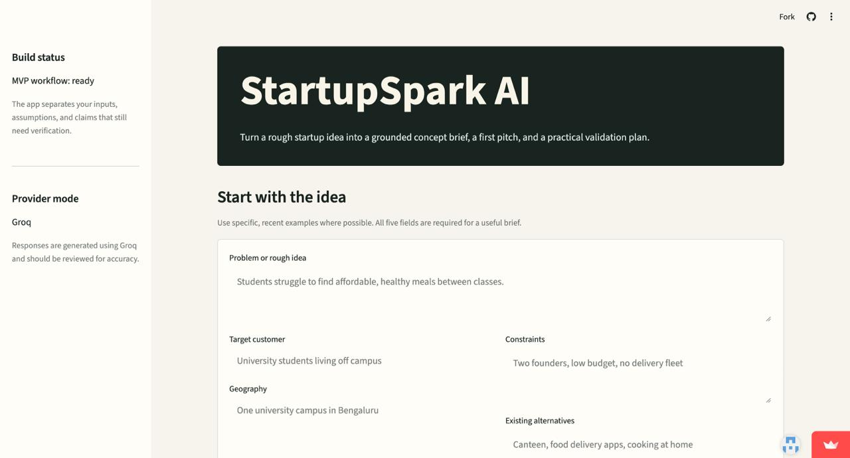

Slide 13
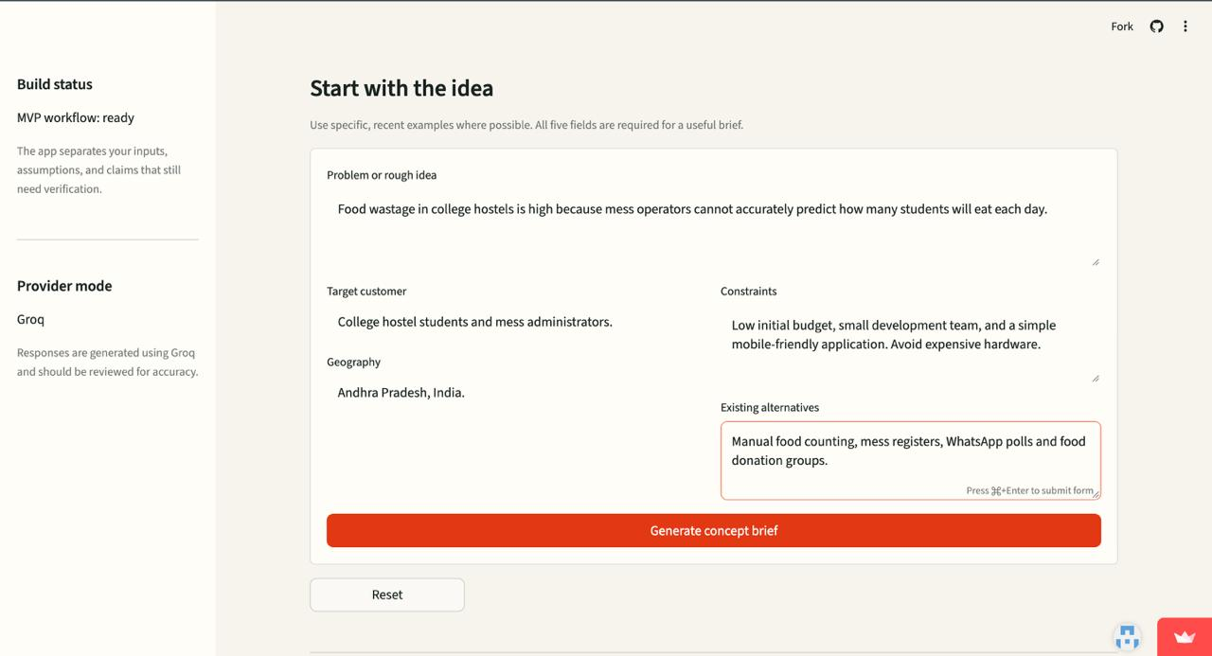

Slide 14
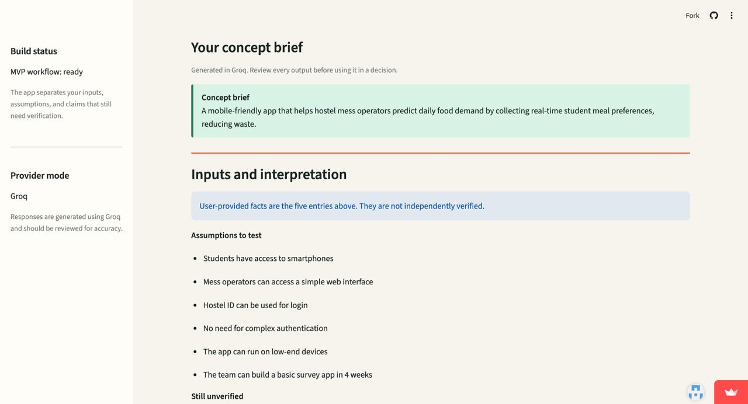
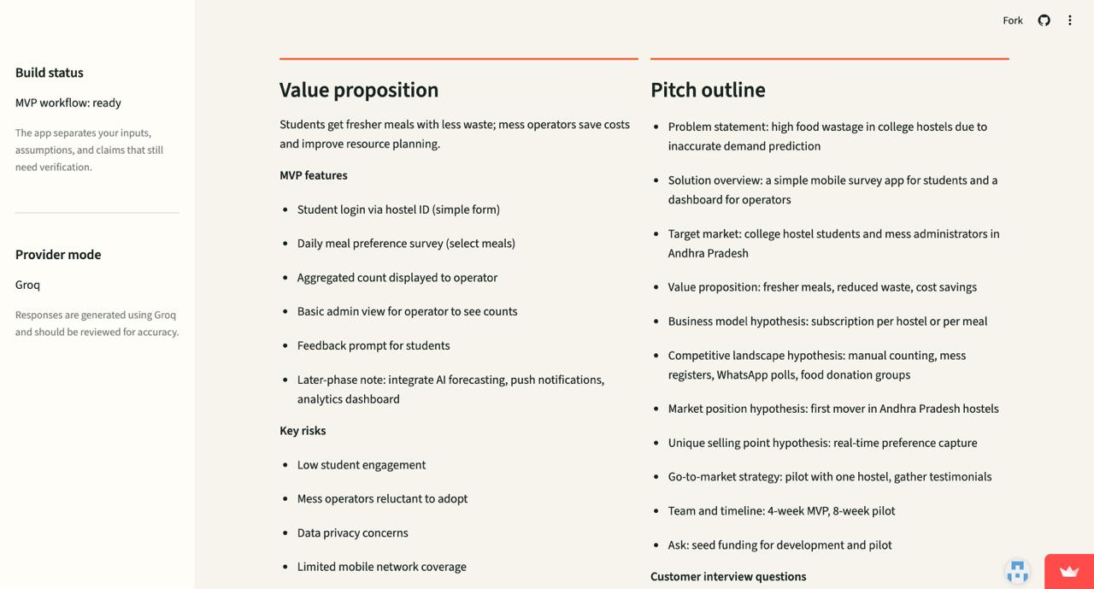

Slide 15
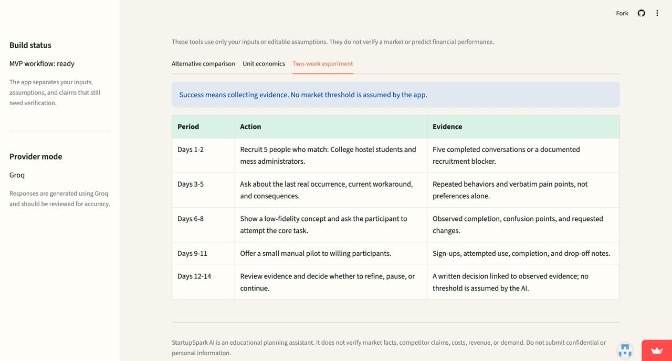

Slide 16
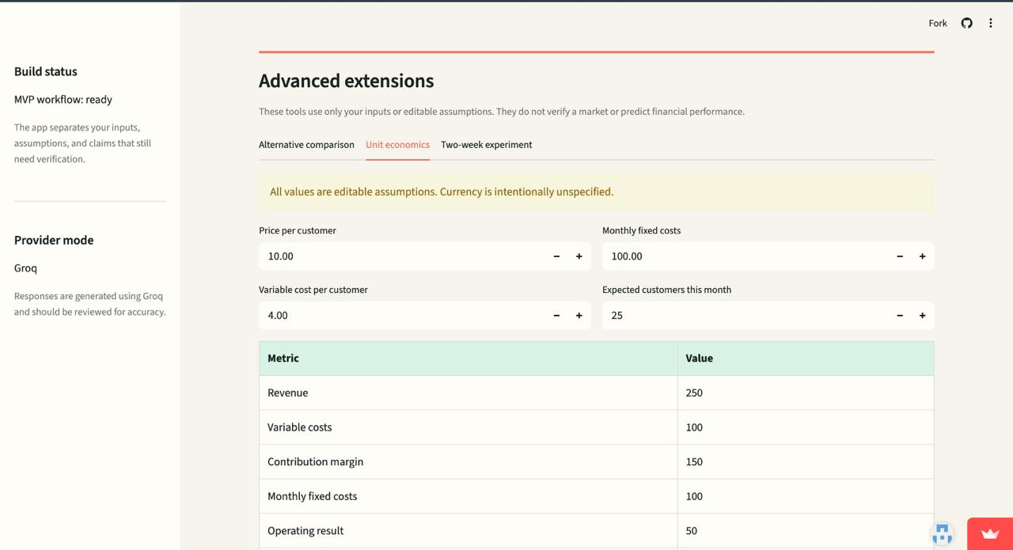

Slide 17
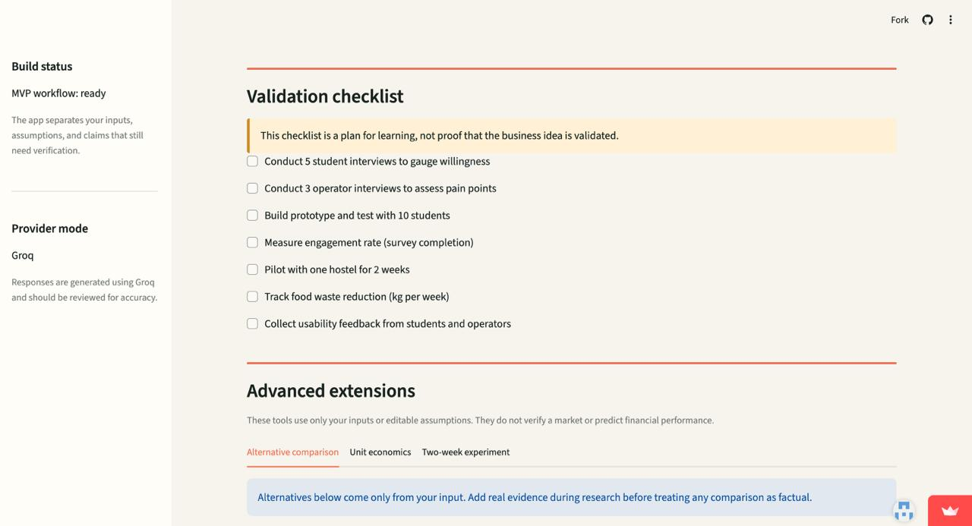

Slide 18
Conclusion and Future Enhancements
StartupSpark AI helps student founders turn an early idea into a structured concept, a first pitch and a practical plan for learning from potential customers.
Future enhancements
Capture and review user feedback
Improve the clarity of generated briefs
Add downloadable concept reports
Expand validation-plan templates
Improve live-provider and deployment checks
Add optional project history with secure storage
The goal is not to prove a business will succeed, but to help founders identify assumptions and test them with evidence.
StartupSpark AI | 12

